Slide 1


C Games
#include <fun.h>
int main ( )
{
/*
where fun begins;
*/
}
return 0;

Slide 2
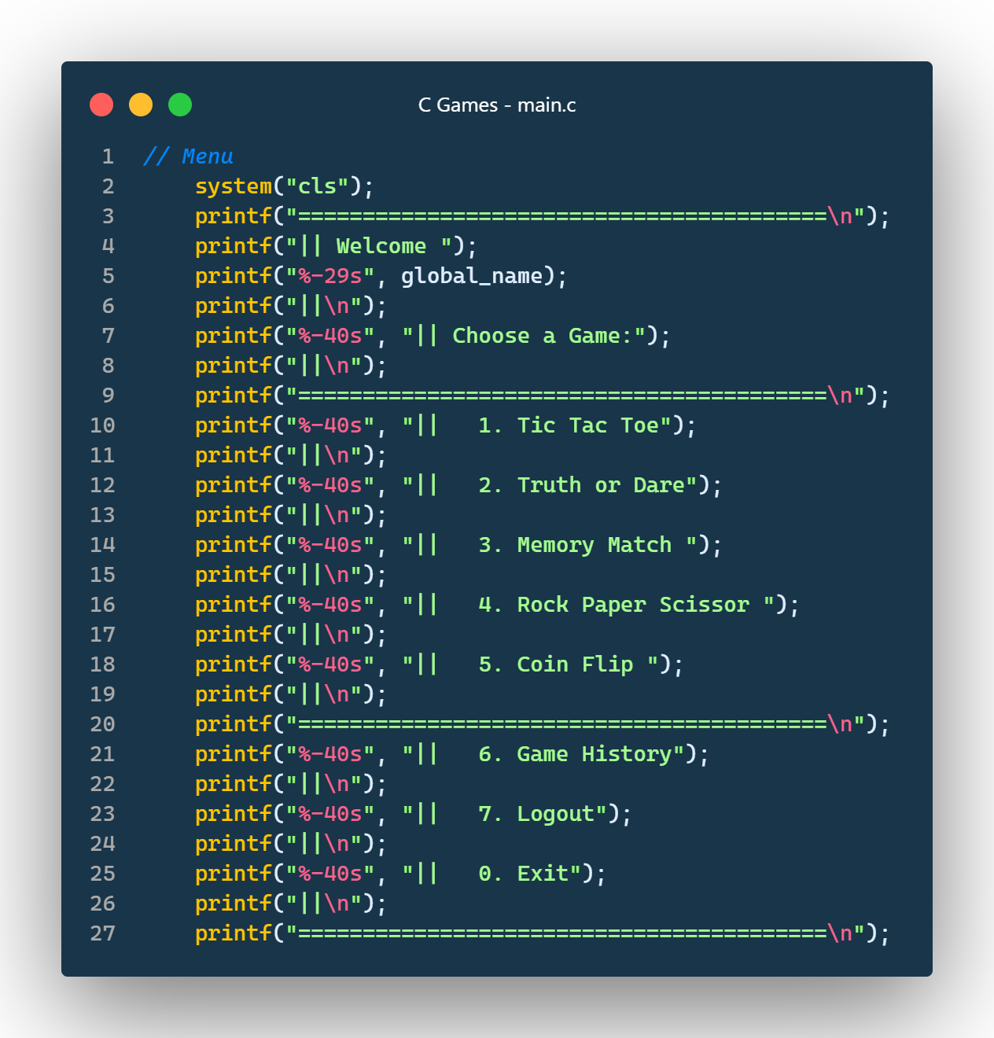
INTRODUCTION
Welcome to C Games - a hub of entertainment and excitement! With a seamless login system and a variety of captivating games, you are in for a delightful gaming experience. Get ready to embark on a thrilling journey of fun and games! Let's dive in!

Slide 3


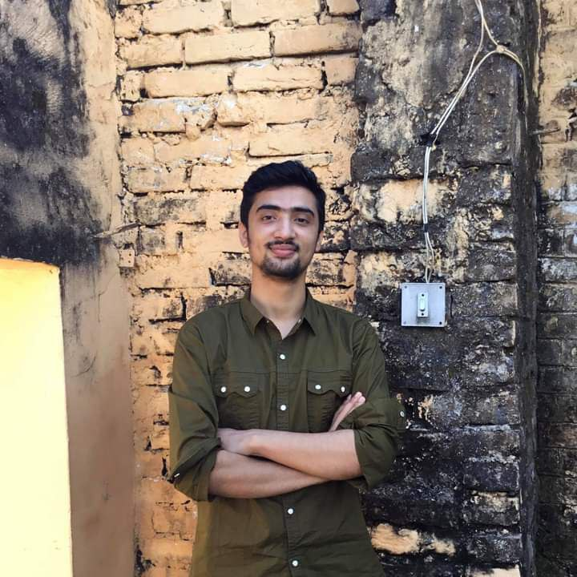

Team Members
Tilak Thapa
Utsab Pandey
Sumit Rijal
Sagar Mainali
BCT-CD-094
BCT-CD-095
BCT-CD-XXX
BCT-CD-069

Slide 4

Tic Tac Toe
"Tic Tac Toe" is a classic two-player game where each player takes turns marking a cell in a 3x3 grid. The goal is to place three marks in a row horizontally, vertically, or diagonally to win. The game continues until a player wins or it's a draw. Enjoy the timeless fun of "Tic Tac Toe"!

Slide 5

Truth or Dare
"Truth or Dare" is a multiplayer party game, where players take turns selecting either truth questions or dares. Players earn points for successfully completing their chosen task. The player with the highest score at the end wins.

Slide 6

Memory Match
"Memory Match" is a single-player game where you must memorize and recall random numbers shown for a few seconds. Score points by entering the correct number in three rounds. Test your memory skills!

Slide 7

Rock Paper Scissor
"Rock Paper Scissors" game where you compete against the computer. Choose 'r' (rock), 'p' (paper), or 's' (scissors), and see who wins! Play multiple rounds or quit with 'q'. Simple and fun!

Slide 8

Coin Flip
"Coin Flip" is a single-player game where you guess if a virtual coin will land on heads or tails. Get it right, and you earn a point; get it wrong, and you lose one. Enter 'h' for heads, 't' for tails, or 'q' to quit. Simple and fun!

Slide 9

LIVE DEMONSTRATION
Effective more than thousand words of explanation………….

Slide 10
THANKS!
Do you have any questions?
https://github.com/jrTilak/C-Games

